Slide 1
An awesome presentation about a … project
Valerian Tschopp

Slide 2
The task
to develop a virtual reality game with Unity
to either use Cardboard, VIVE or the Oculus Quest
based on the words „mystery“ and „physics“

Slide 3
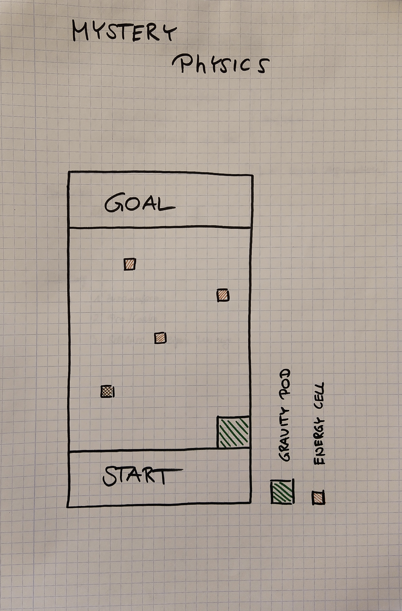
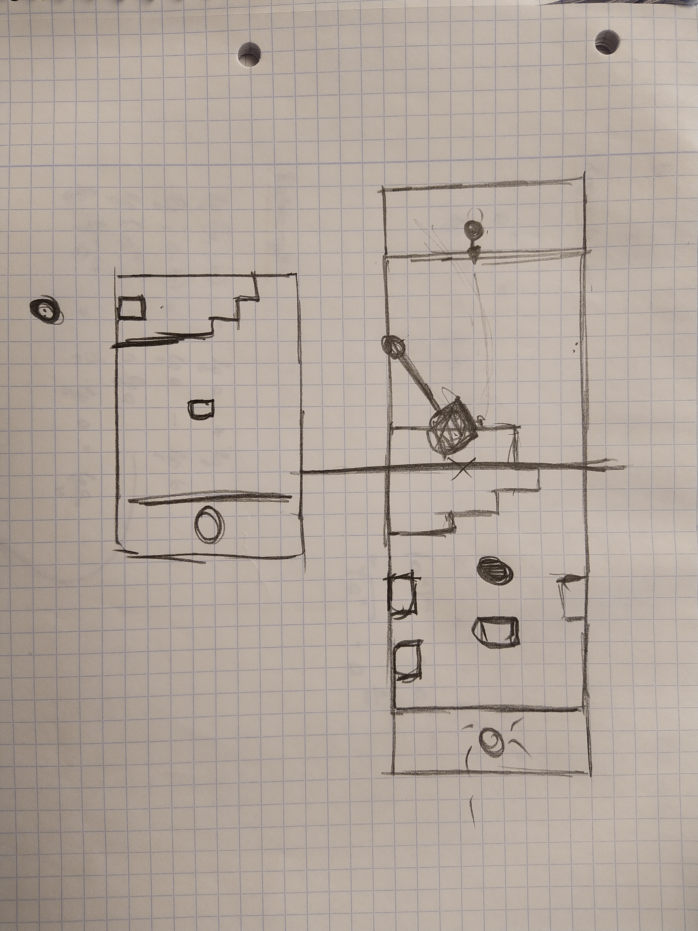

Slide 4
The problems … part 1
Oculus Quest
terrible documentation
developer account is necessary
organisation
application
Android SDK
USB-C

Slide 5
The problems … part 2
switched to the VIVE
made a succesful test in VR
SteamVR Plugin
simple level with cubes
spawning of energy cells
added a spinning globe

Slide 6
Wait, this aren‘t problems?!
This is 100% success story!

Slide 7
Nope!
Thats where you‘re wrong, kiddo!

Slide 8
The real problems … part 2
I have no virtual reality system at home
VR is using a smaller scale then the classical approach
I have no virtual reality system at home

Slide 9
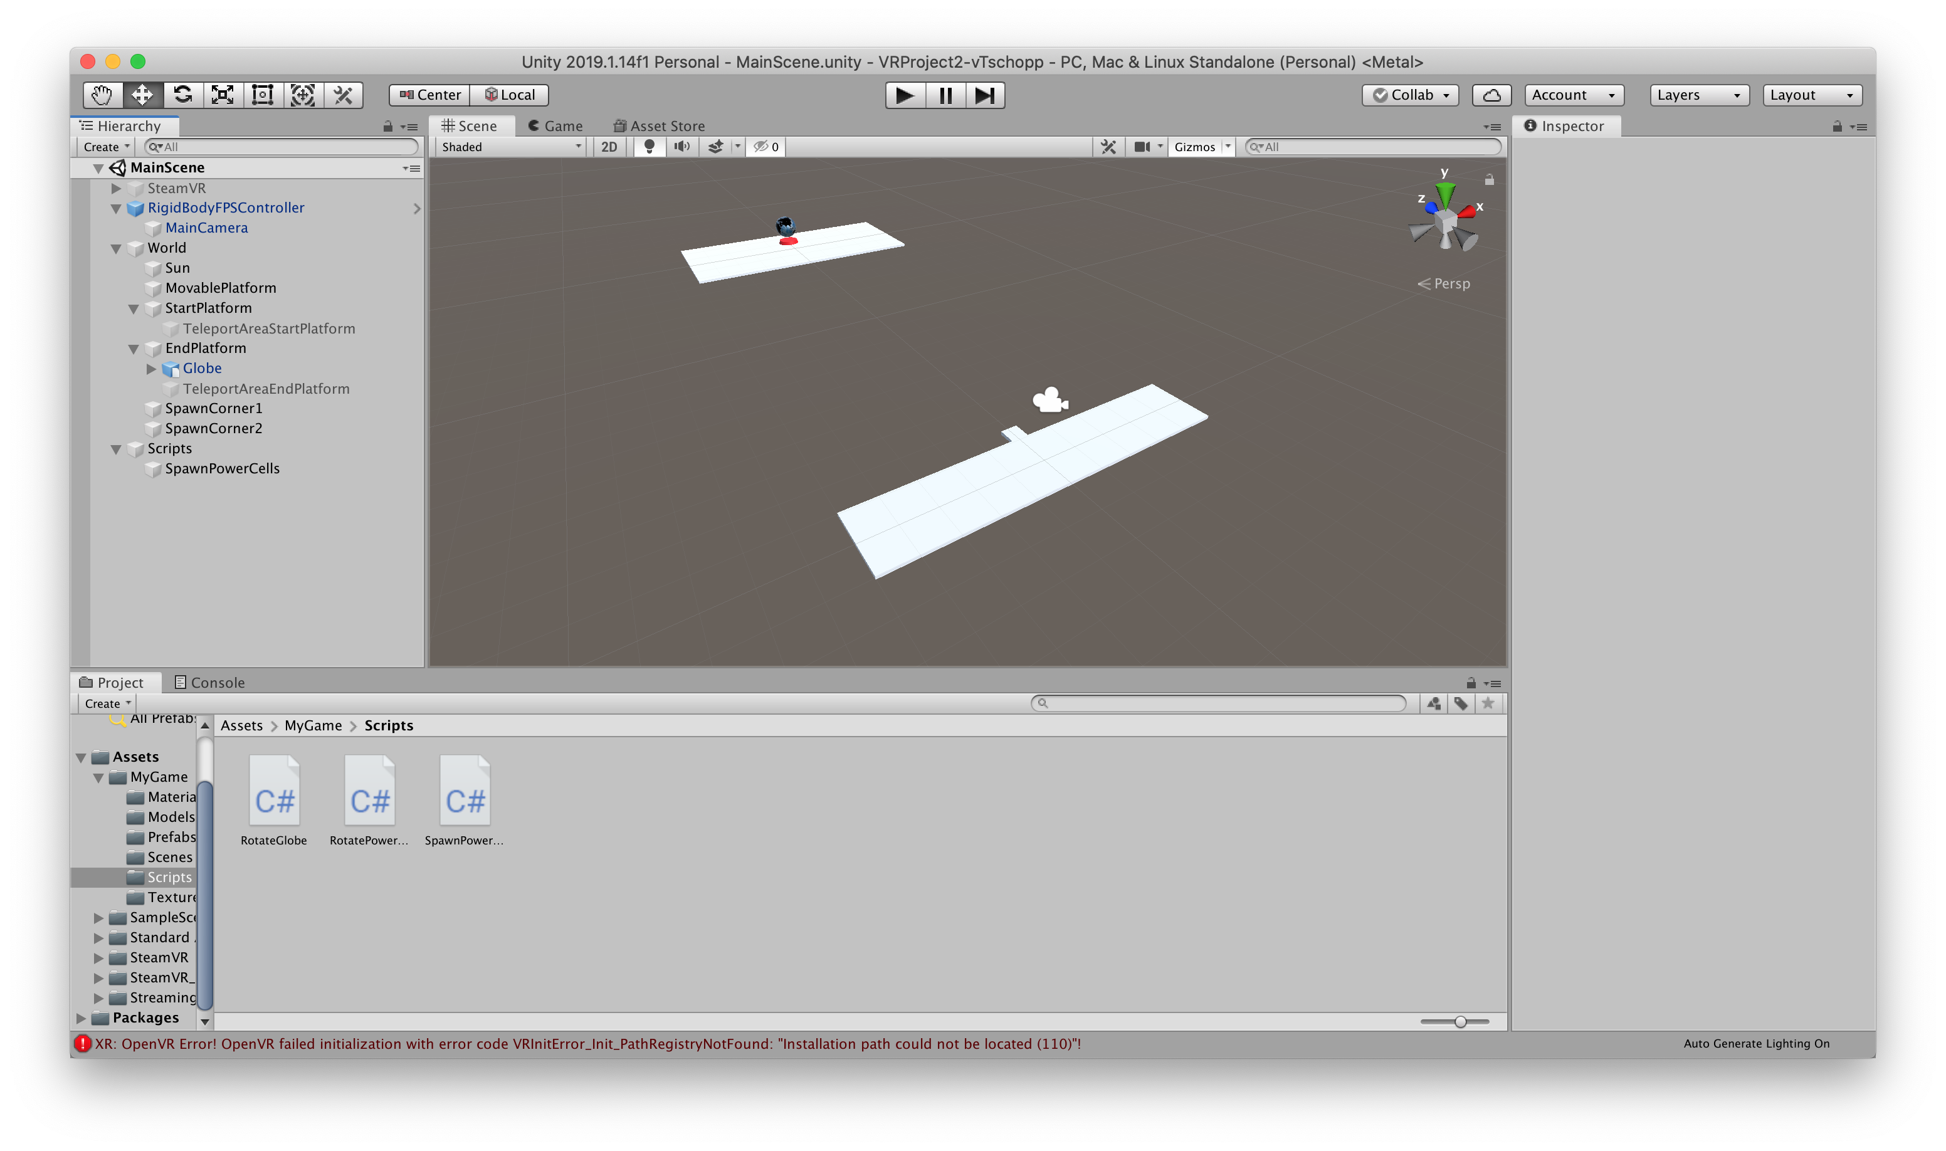

Slide 10
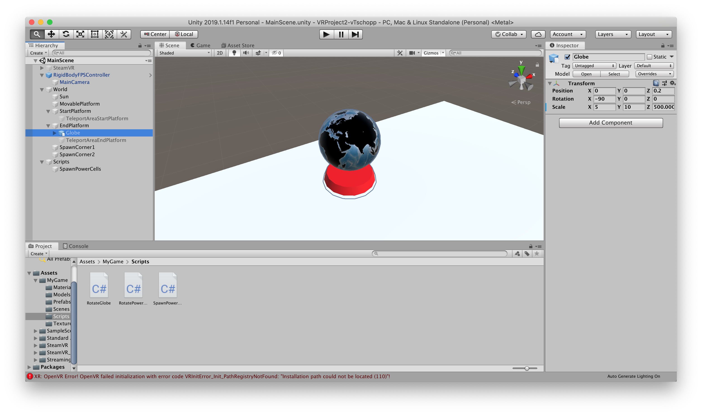

Slide 11
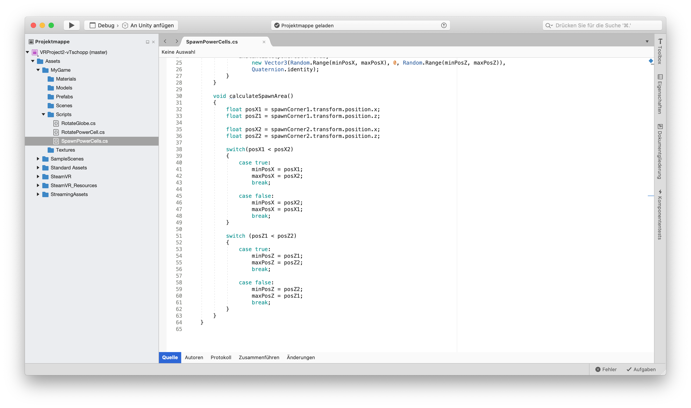

Slide 12
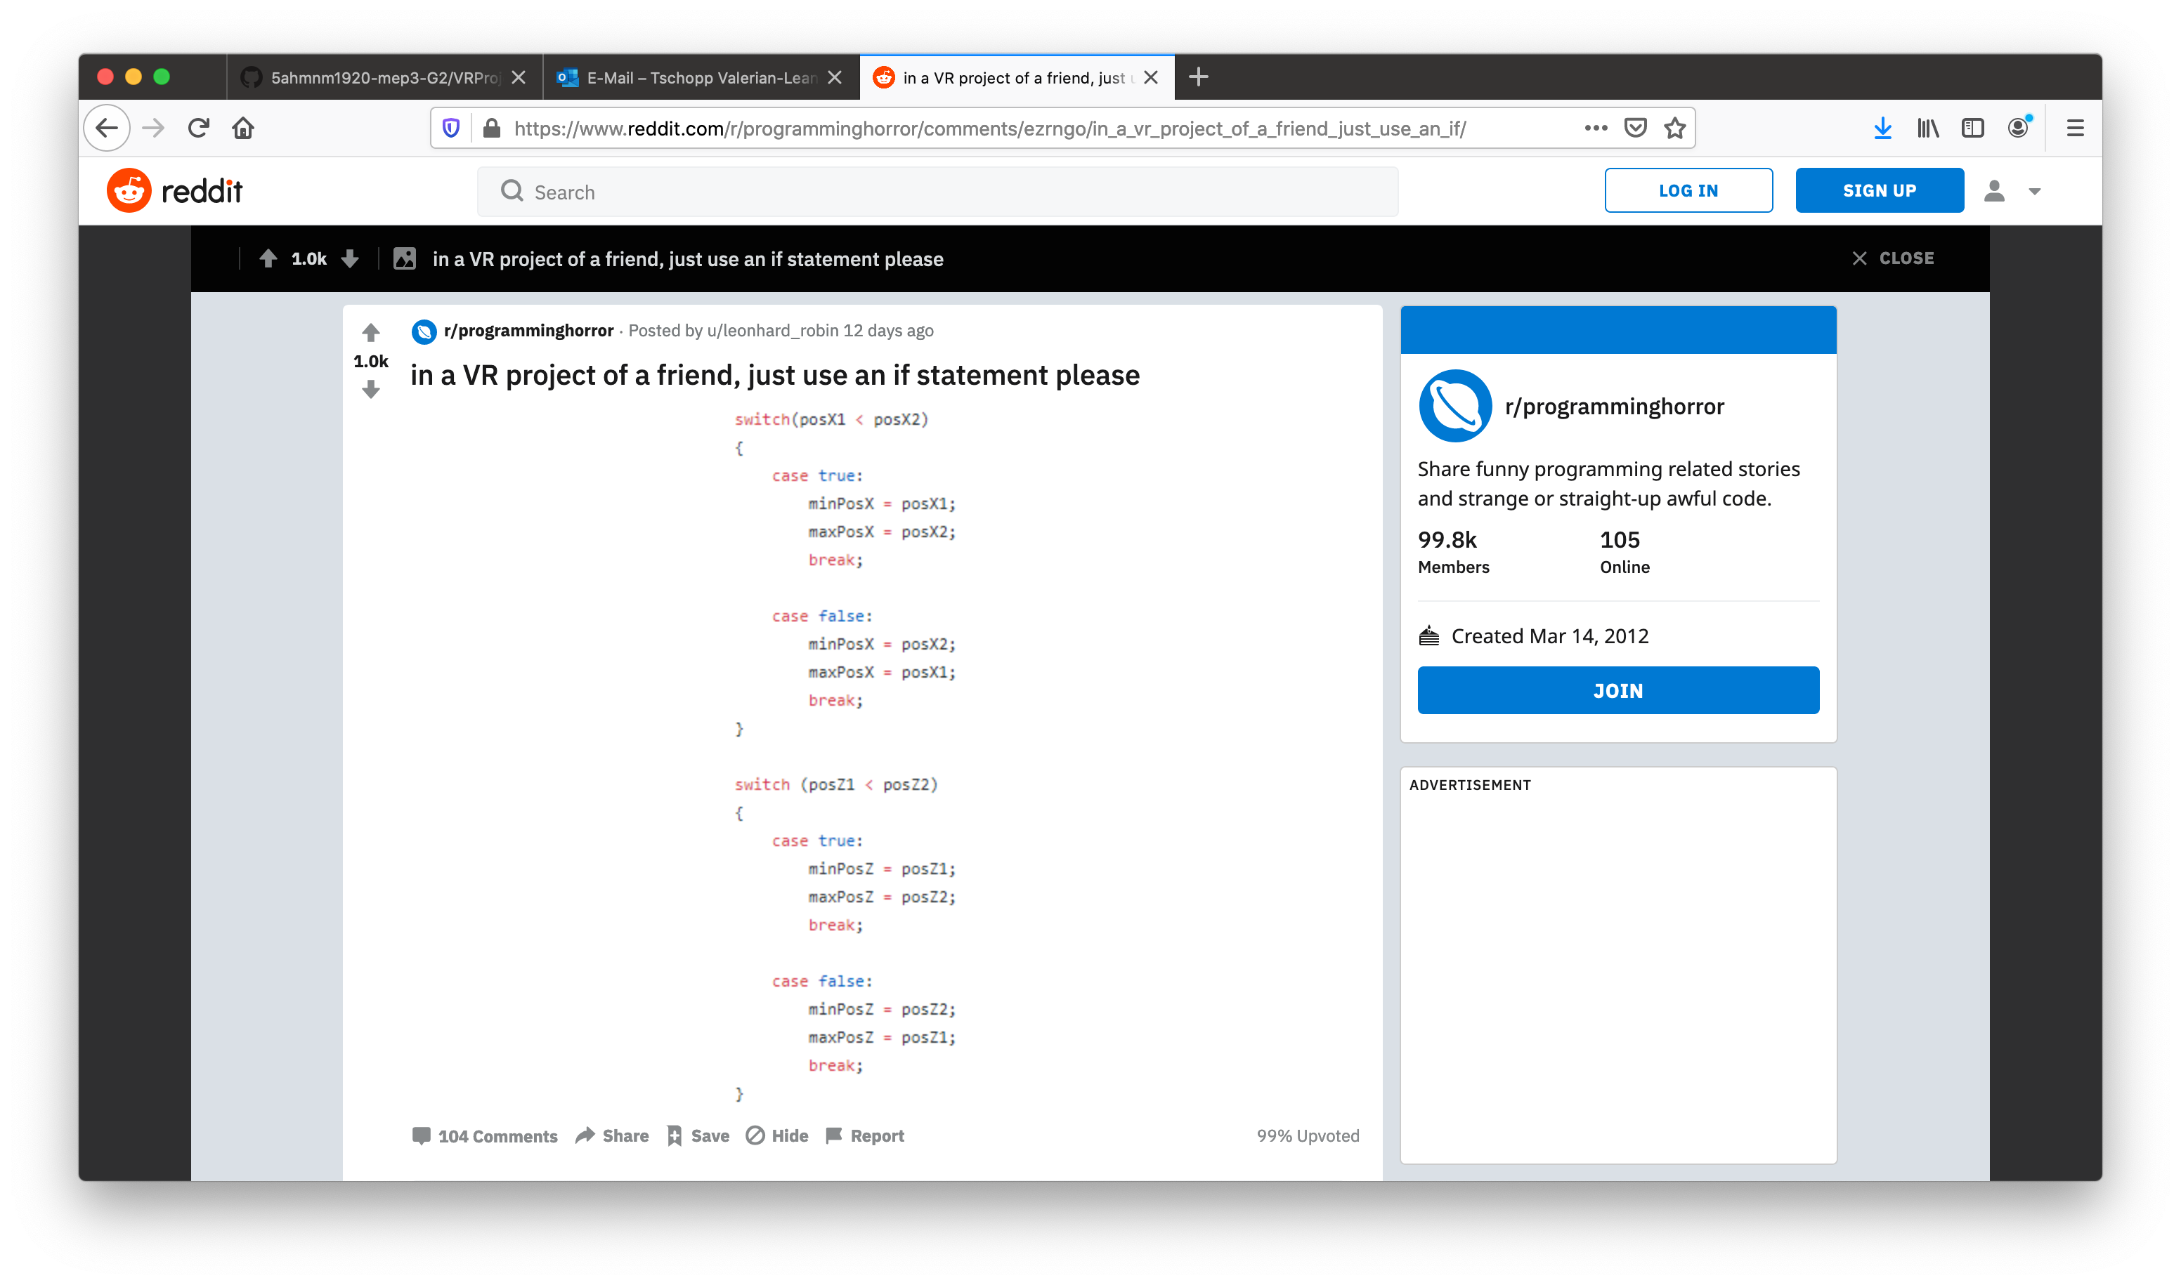

Slide 13
Thanks for your attention!
© 2020 Valerian Tschopp

